Slide 1

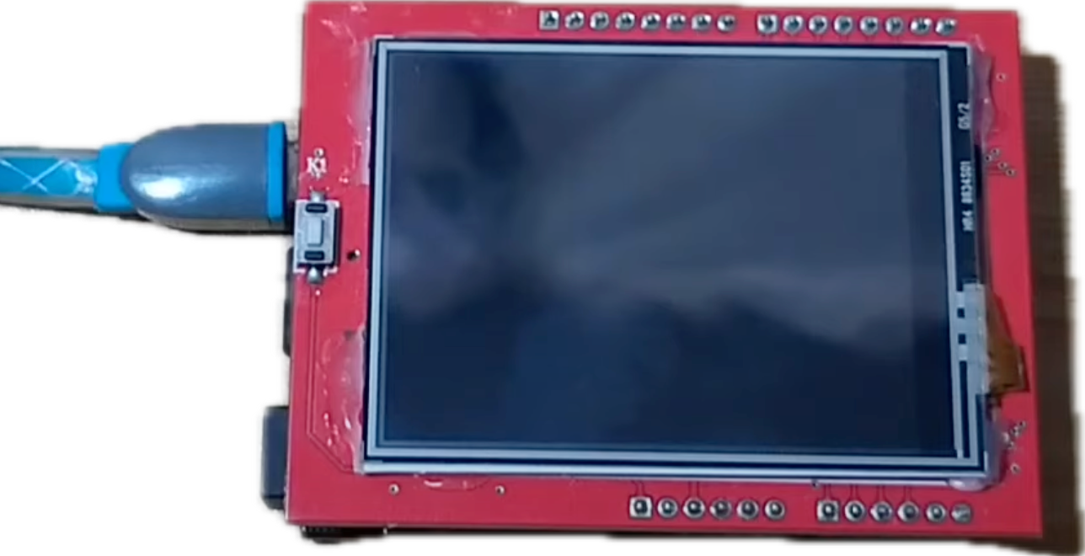
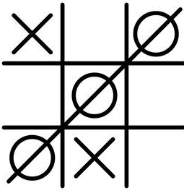
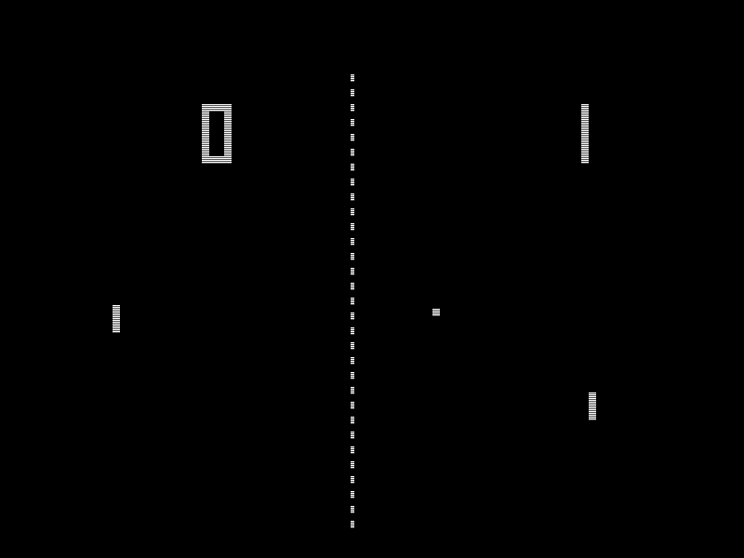
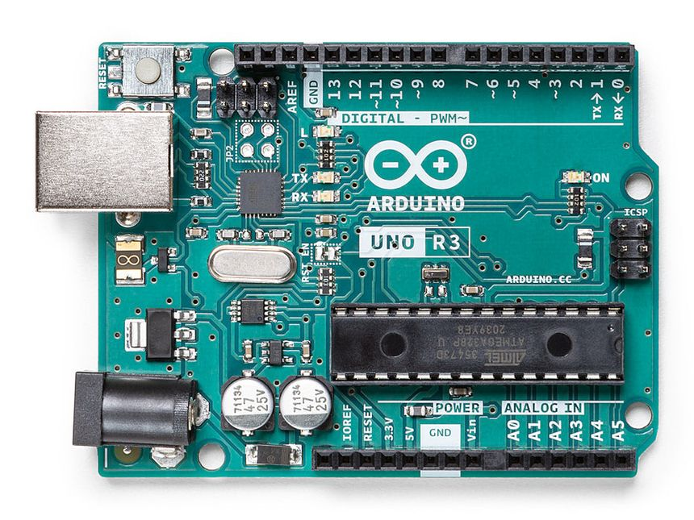
Play Games
Team Member Names: Abhishek Goel, Moharir Ameya Nitin, Devansh Negi, Karan Bhalla
Mentor: Aditya Singh Bisht, Parth Mittal (SDSLabs)
Faculty Supervisor Name: Prof. Ekant Sharma, Prof. Meenakshi Rawat (ECE)
Problem Statement
Prototype/Experiment Details
The problem statement was to create playable, multiplayer video games that will be displayed on a display screen and playable by a person using the appropriate controller.
It was understood by the members that for accomplishing the project, the appropriate code or program will have to be written for the video game. Also, a microcontroller board will be required, connected to a display screen (where game will actually be displayed) and buttons(for controlling the game).
The selected games were “Ping Pong” (pixelated Table Tennis) and “Tic Tac Toe”.
The prototype consists of the video games Ping Pong and Tic Tac Toe, written on Arduino IDE, and uploaded to Arduino UNO through USB.
The games will be displayed on a TFT (Thin Film Transistor) 2.4-inch LCD display, and they will be playable by two players using push button, placed on a breadboard.
Methodology
Results & Discussion
Project Scope
Develop Game Code
After spending considerable number of hours on the project, we have written the code and uploaded it to the Arduino UNO.
The end result led to the following video games:
Ping Pong, playable by two players using two push buttons each and if either player reaches score of 9, the winner player number is displayed.
Tic tac toe is also created which can be played by 2 players.
Select Games: Ping Pong, Tic Tac Toe
Write Code on Computer
Multiplayer & Computer Player Support
Upload Code to Arduino
Choose Hardware Platform
Connect Components
Arduino Uno
Conclusion & Applications
Connect Arduino to Display
We have successfully created video games using Arduino microcontroller.
Also, many other games such as Flappy Bird, Snake can be created by writing their respective codes and using the appropriate controllers.
Also, features such as audio feedback and multiplayer options can be implemented using Speakers and Bluetooth Modules.
Thus, Arduino is a useful Microcontroller Board, useful for many software purposes ranging from sending to receiving signals to creating actual video games.
Display Screen
Connect Arduino to Buttons
Game Controller Buttons
Use Breadboard & Wires for Connections
Breadboard & Wires
Course TMI -101 (Tinkering)
Presentation Group # & POSTER ID #
4
SDS-9

